Slide 1
On a quest for wellbeing
Purposeful outdoor projects to profit people and planet
Green Therapy Evaluation July 2018

Slide 2
Content
Overview
Green Therapy
Evaluation methods
Results
Conclusions
What’s next

Slide 3
Overview
Green Therapy has engaged 25 VIPs who have enjoyed gardening and art classes at Lifeways Centre.
We are working with 37 Signposters who now refer people to the project
We have 5 key success stories to report with significant improvements in wellbeing and reduction in obesity
We are working on Green Therapy 2 and are providing progression opportunities for all participants

Slide 4
Evaluation methods
Pre and post questionnaire
Interviews with participants
Video case studies
Group feedback
Observation
Social media posts

Slide 5
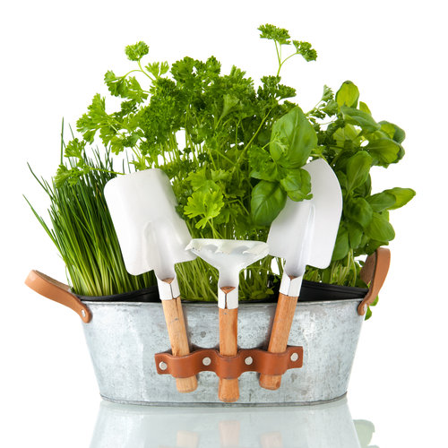
Green Therapy
The natural environment to feel better
www.forestofhearts.com/greentherapy
Enjoy fresh air | Do something new| Meet people | Keep fit | Learn skills
Lovely secret garden | No experience necessary | Chill out time| Get outdoors
Places strictly limited
FREE
places available
Enjoy gardening
Choose
one or
both
Enjoy making art in nature
For more information go to www.forestofhearts.com/greentherapy or to register your interest, contact mandy.berry@hotmail.co.uk or call 07403 749819
Social prescribing is about linking people up to social or physical activities in the community with a wide range of benefits to improve health and wellbeing, reduce obesity and reduce social isolation
Project part funded thanks to a HRUK and Subway® Healthy Heart Grant

Slide 6
Green Therapy
The natural environment to feel better
www.forestofhearts.com/greentherapy
Enjoy fresh air | Do something new| Meet people | Keep fit | Learn skills
Lovely secret garden | No experience necessary | Chill out time| Get outdoors
The Secret Garden Lifeways Centre 30 Albany Road Stratford upon Avon CV37 6PG | Garden Gym | Grow Create
 | 11.30 – 13.00 | 11.30 – 13.00
 | 14.00 - 15.30 | 14.00 - 15.30
For more information go to www.forestofhearts.com/greentherapy or to register your interest, contact mandy.berry@hotmail.co.uk or call 07403 749819
Twitter | Facebook | Website
@forestofhearts | forestofheartsStratford | Forestofhearts.com
Places strictly limited
FREE
places available
Social prescribing is about linking people up to social or physical activities in the community with a wide range of benefits to improve health and wellbeing, reduce obesity and reduce social isolation
Project part funded thanks to a HRUK and Subway® Healthy Heart Grant

Slide 7
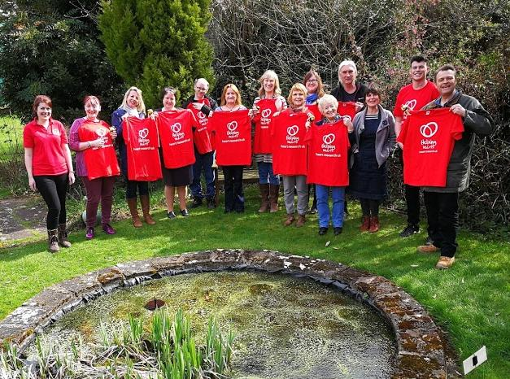
37 Signposters engaged

Slide 8
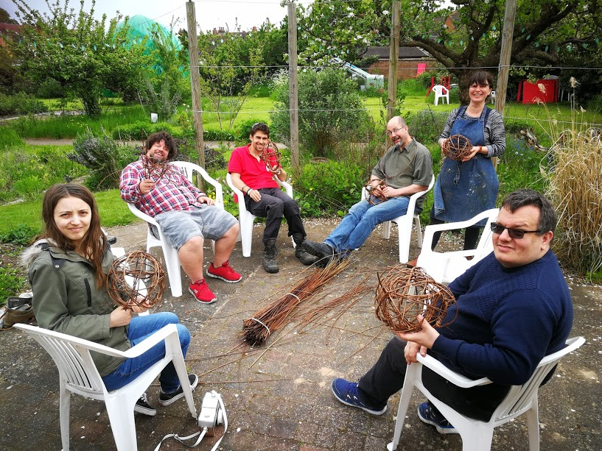
25 VIPs engaged

Slide 9
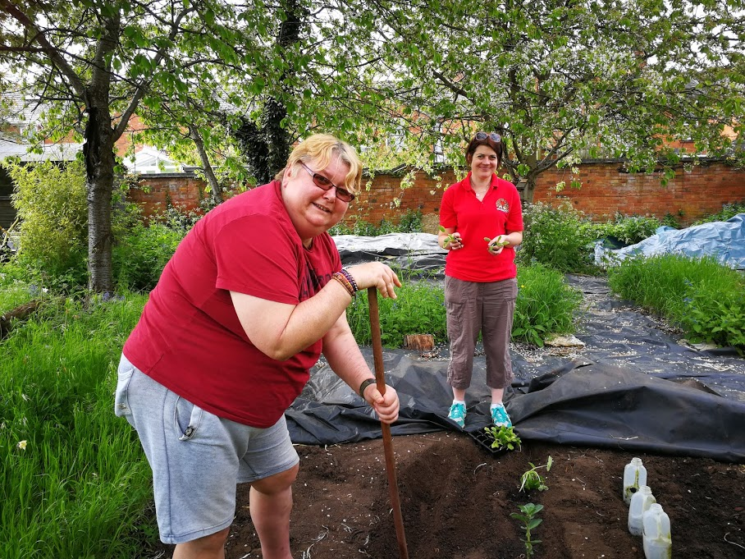
88 new vegetables grown

Slide 10
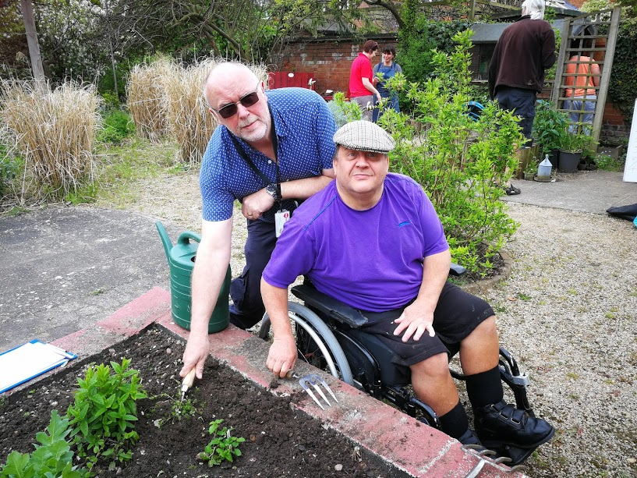
180 volunteer hours given

Slide 11
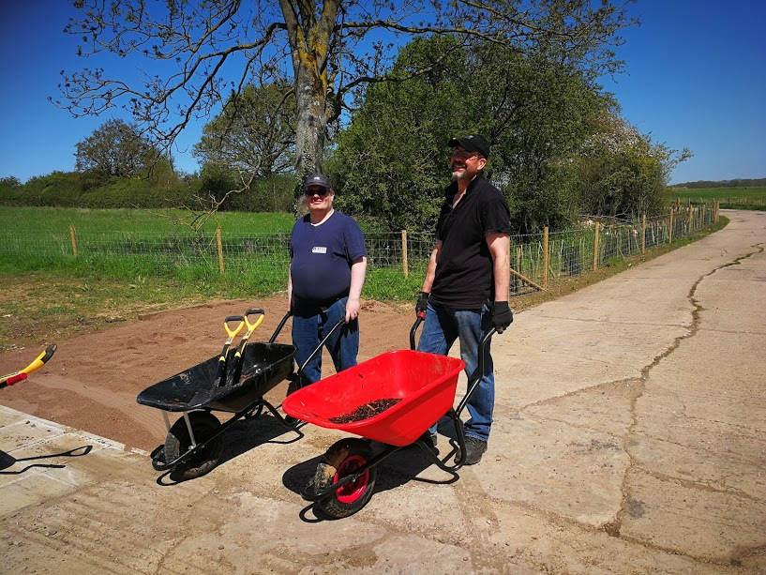
2 new gardens created

Slide 12
22 learnt new skills

Slide 13
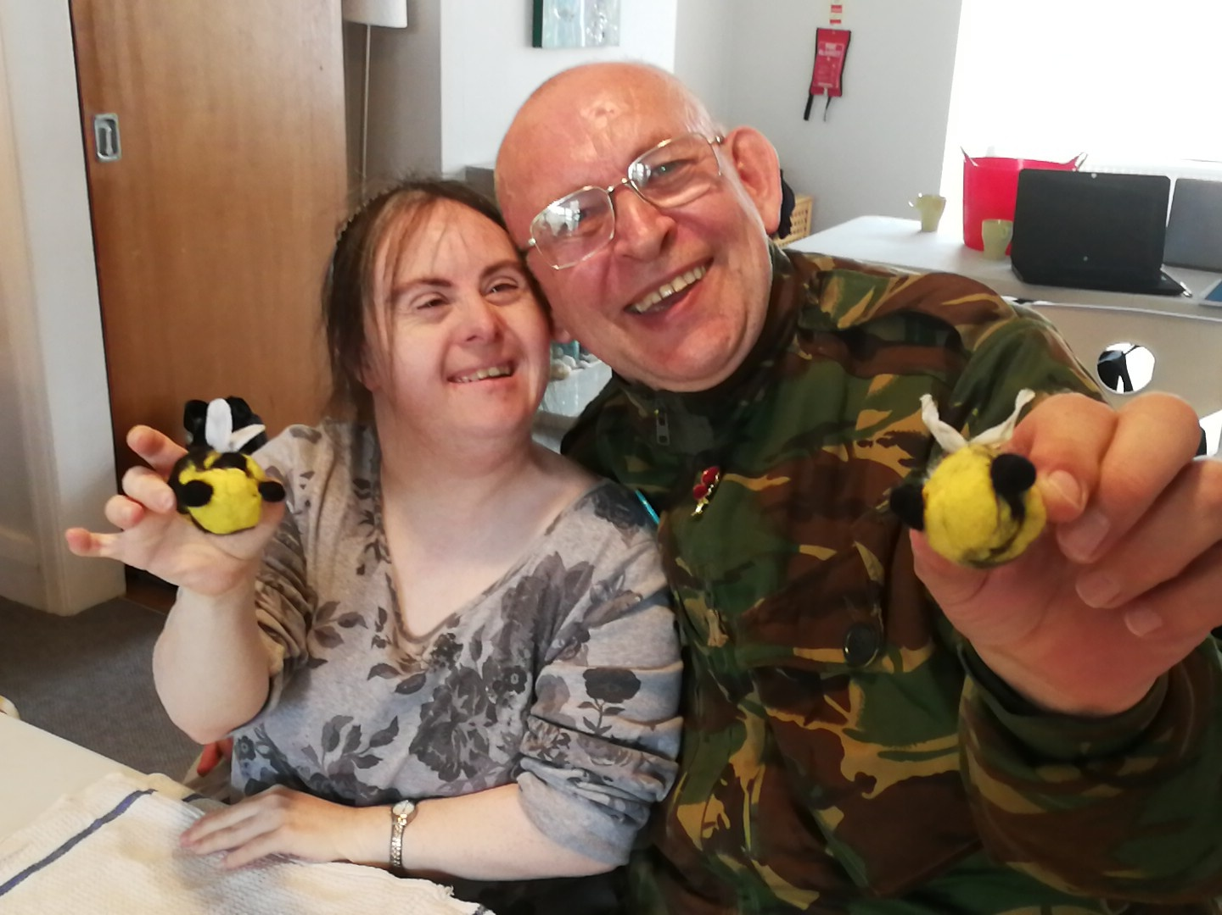
10 people looking forward to the future

Slide 14
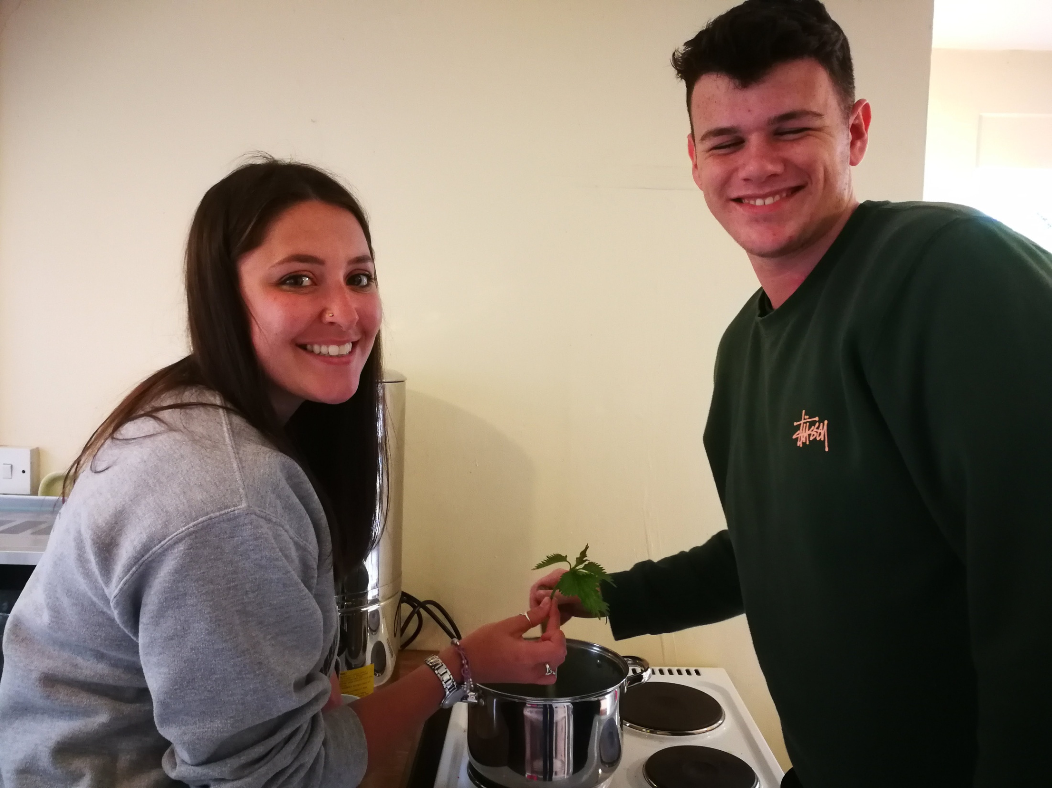
32 healthy meals shared

Slide 15
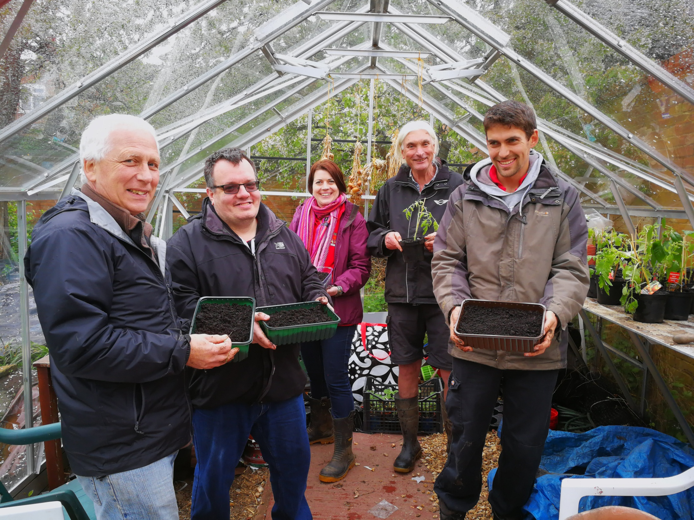
200 plants propagated

Slide 16
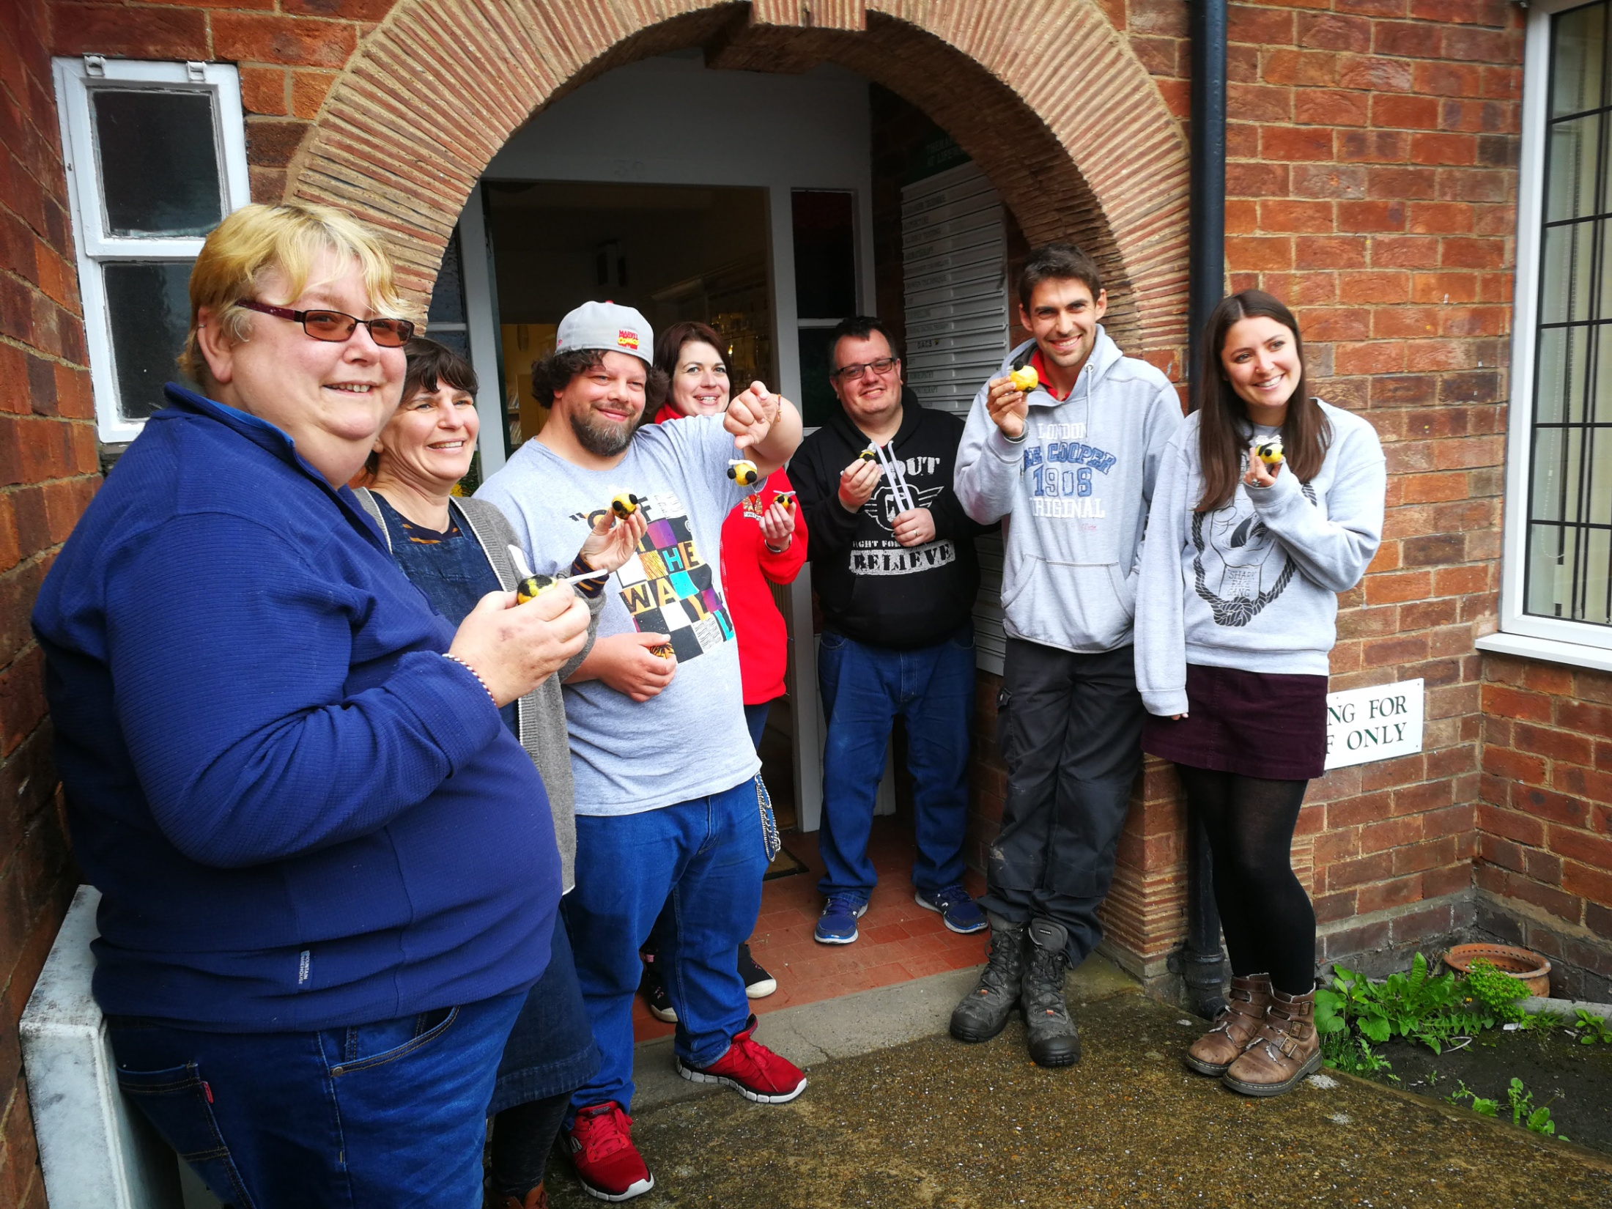
20 meeting new people

Slide 17
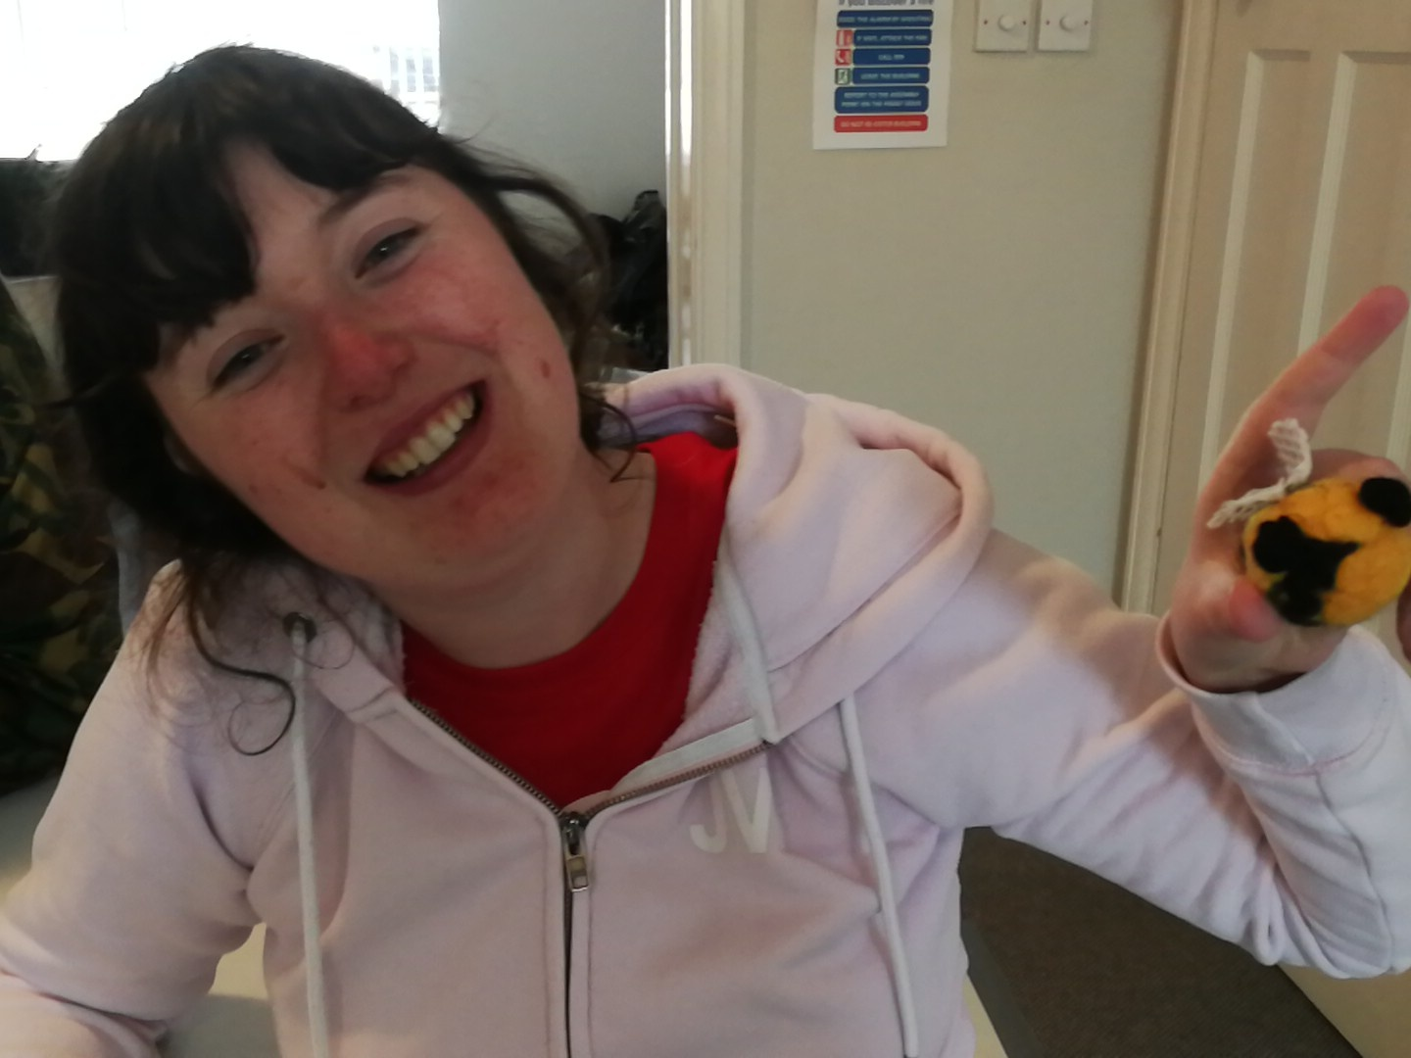
‘Really enjoyed project and would like to do it again. Made loads of friends learnt different art skills

Slide 18
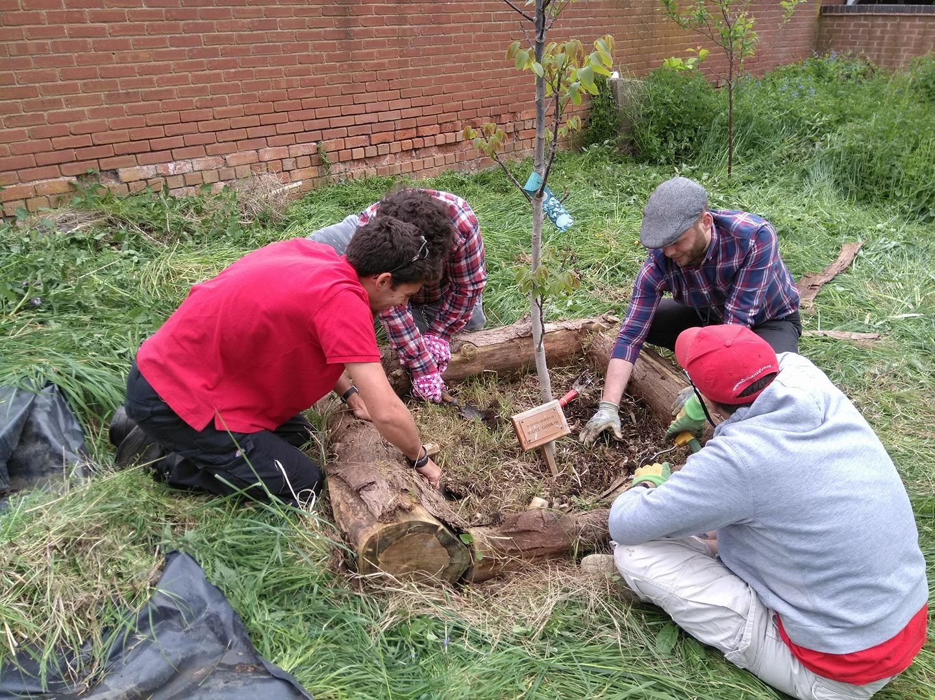
2 Forest Gardens planted

Slide 19
Success Story - Debbie
Success Story

Slide 20
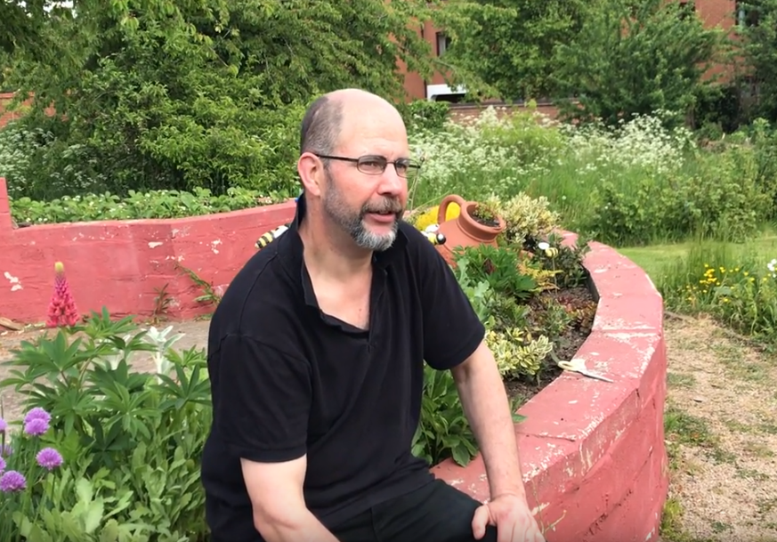
Success Story

Slide 21
Success Story
There’s still a long way to go but I am getting out every day, mixing with others, losing weight. Helping with depression, GP happy with progress, instead of 200mg of tablets I am now on 150mg. I have lost over half a stone!

Slide 22
Success Story

Slide 23
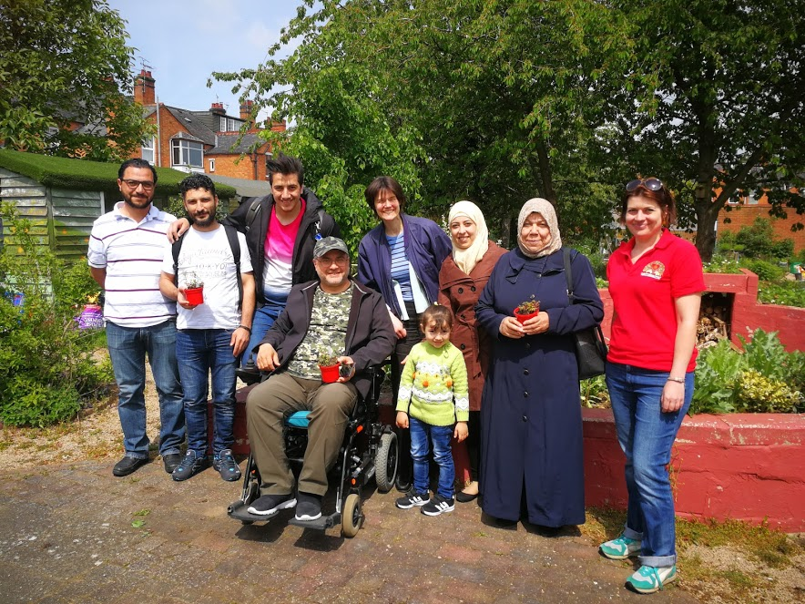
7 Syrian refugees benefit

Slide 24
James- Manager of Lifeways
This is certainly most professionally organised project, within last 9 years I’ve been here. The team running it are superb, the way they have worked means that my input is minimal which is great as I can be very busy. The number of organisations the project have engaged with wanted. to for a long time Mencap, Springfield mind, looking after community garden, space it needs to be . gardening takes time and effort, always been a strategy to ensure has a feedback to community. Project is perfect conduit for that, personally seen people on project & obviously get huge out of it fills the place with laughter, garden looks terrific, support staff are helpful and supportive.
Negatives= own resources, very little parking spaces and very busy, length of time project is on, like it when people don’t walk in on counselling sessions. Making it ongoing, personally don’t believe it can be social enterprise at least 50% of income needed is provided by goods and services people couldn’t fund it themselves. needs to be funded on groundwork basis.
Confident that trustees would provide support and use of garden free and would be free, happy to partner with other organisation for project to be ongoing, let the room for arts at charity rate, keeping costs low.

Slide 26
How are you doing results

Slide 27
Green Therapy Training for Signposters - Feedback
6th April 2018
Lifeways Centre

Slide 28
What did you think/feel/see/do/experience that was of benefit to you?
Very relaxing and therapeutic activities
Liked both of them
Great tutor support on both
It was good to know what was going on
Could have been longer and more details
I benefitted knowing that nature still has a role to play in recovery and wellbeing
I appreciated the knowledgeable staff and relaxed and friendly way the day was designed
Social prescribing into such activities incorporates all of the five ways to wellbeing, so I found this great and will signpost
Enjoyed laughter and fun with people I had not previously met
Learned that the end result (bee) is much more successful than initially appeared i.e. Perseverance

Slide 29
What did you think/feel/see/do/experience that was of benefit to you?
Enjoyed calm and peace spent “planting” peas
Learned more about Forest of Hearts and what the project is about
Interested in passing on information to my students
Loved planting and making!
Lifeways has always been an organisation I’ve just “known about”, today has made Lifeways come to life
I’ve enjoyed meeting staff and all attendees
I enjoyed all the activities
I feel extremely encouraged to refer as I can see the benefits of Green Therapy
Having a slow wander around the garden, feels a “safe” area
Seeing all different plants and structures and the different areas
I look forward to seeing it when the garden is in flower and the veggies are growing
A few seating areas or odd wooden seats may be a good idea?

Slide 30
What did you think/feel/see/do/experience that was of benefit to you?
Made me aware of activities suitable for Mencap customers
Helpful to me in my role as volunteer co-ordinator
Thoroughly enjoyed the activities
An excellent experience that promoted a sense of wellbeing
Feel it would be ideal for many of our vulnerable customers
Thank you for the opportunity
Very beneficial to see how it made me feel
Very good fun and lots of laughter – so good to see first hand how it would help

Slide 31
What has been enjoyable and/or useful about today?
Useful to see activities that Mencap customers could take part in
Enjoyed both activities
Learning about the project
Meeting organisers and participants
Meeting new people
Learning about Lifeways
Finding out about the project
Found out a lot more about Green Therapy and Lifeways
Great to experience the activities and the peace offered by the fabulous garden here
Great fun – very relaxed
Great hospitality
Thank you for a very enjoyable day

Slide 32
What has been enjoyable and/or useful about today?
It’s been lovely fun relaxed day and it was wonderful to meet like-minded people
Thank you! I love my bee!
Taking part in the actual activities
Art/craft activity and looking around the garden
Teamworking
Environmnent
Will definitely recommend to others
An excellent day. Thank you
Direct experience of the acivities

Slide 33
What improvements could be made?
Overview of the programme for clients and longer window to refer
Detailing the sessions – times and dates
Nice quirky seating areas
Clearer info on all aspects of the project
The leaflet needs to have that it’s an 8 week activity
I remain concerned that the tight deadline – 2 weeks to first induction is very quick especially when dealing with isolated clients who may lack confidence
Longer – more details of the project
More time to manage
More details about 8 week programme

Slide 34
What do we need to do to make Green Therapy successful?
Communication – very important
Let clients see outputs
Look at wider issues eg transport
Sustainability is always key
Partnership working is a fundamental part of this
Consider extending launch date
A different start date later on to give people time to communicate to their colleagues and service users
Good advertising amongst partner organisations
Ensure full cohort of participants
Transport for isolated clients

Slide 35
“Not only has the project helped with weight loss and helped my back it's also helped with my depression since August last year I was struggling to leave the house and would lock myself away but since this project it's got me back out into the community.”

Slide 36
Next steps
Seek further funding/sustainable options
Progression onto Green Therapy 2
Progression on to Harvest Share
Progression on to Lend a hand on the land
Progression on to the Gardening Party
Progression on to Walkie Tallie

Slide 37
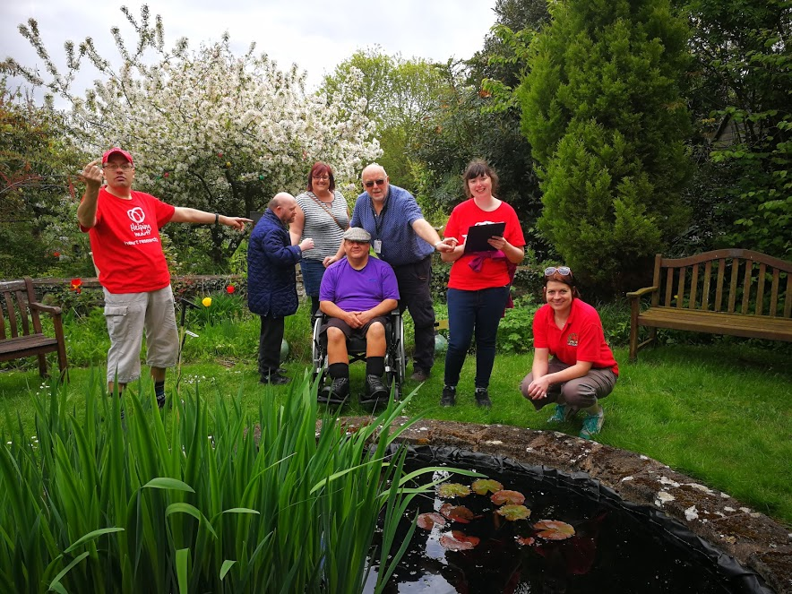
A joyful summer 2018

Slide 38
On a quest for wellbeing
Purposeful outdoor projects to profit people and planet
Green Therapy Evaluation July 2018

