Slide 1
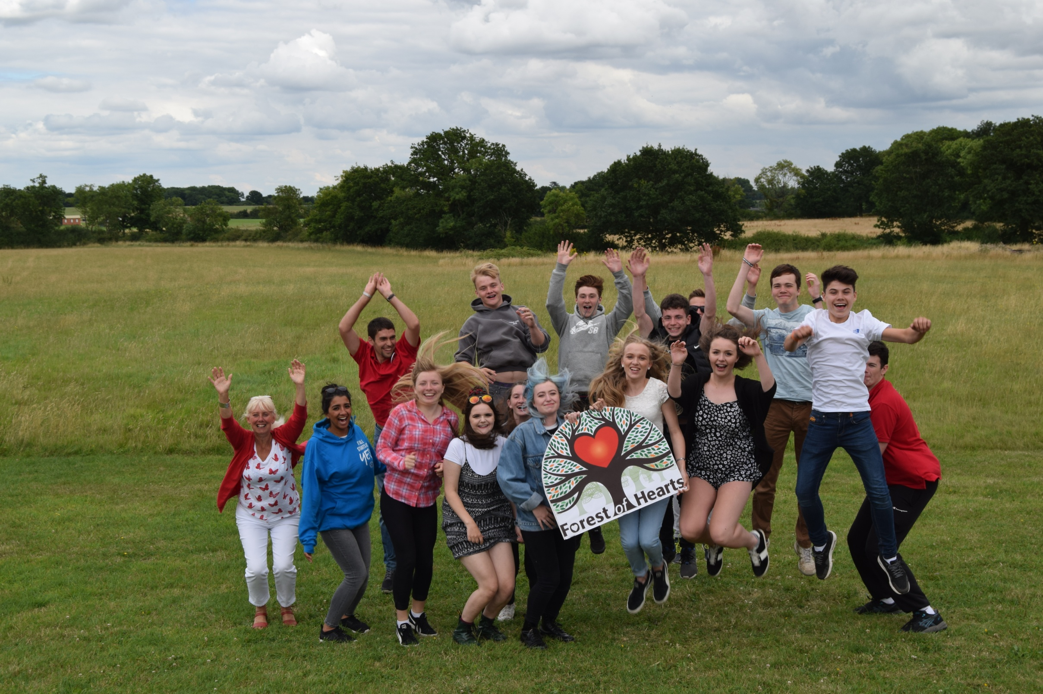
Forest of Hearts
To boost biodiversity, wellbeing and employability by creating and maintaining edible gardens and green spaces
Notes:
We are creating a five acre haven for biodiversity which will include new woodland and an orchard, two large ponds and meadows. The work begins in 2020 and the newly created green space will kept for wildlife and be available for selected groups to use for outdoor education and recreation.
Project Description
The project combines the development of biodiversity rich, highly accessible site with a sensitive interpretation of the sites historic past. It will:
Create a Green masterplan comprising aquatic, woodland, orchard and grassland habitats
Provide accessible pathways and wooden cabins for therapy and coaching
Conserve a RAF Picket Post and interpret the sites activity during the second world war
Provide a site for activity by user groups will particular learning, sports, training and accessibility needs.

Slide 2
Income streams 2022
Grants £68k
EDP, Awards for All, Kickstart, McCarthy Stone, May 29th 1961, Simon Rivett Trust, SSE
Contract £86k
WCC Living walls, SWFT Hospital gardens, RSC Garden, ESF Groundwork Skills for Sustainability - all with paying volunteers and gifts in kind
Events £18k
Munich Re, England Netball, BAT, London Speaker Bureau, DHL Aviation, Iemployability,
Donations £9k
Wipro match funding for tree planting, Isabel Taylor, Gitta Tangue

Slide 3
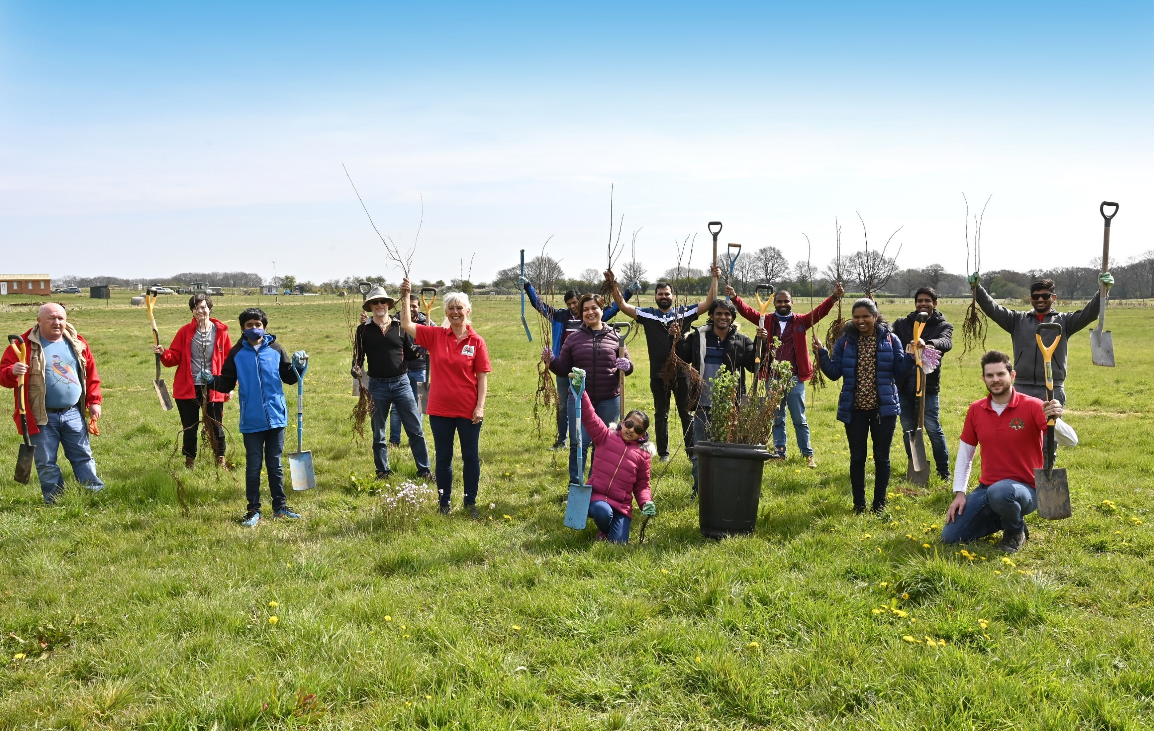
CSR & Green Team Events

Slide 4
Benefits of team building with Forest of Hearts
Suitable for delivery at all venues
Supporting local environmental projects
Outdoor activities with a green theme
Supports CSR and ESG goals
Practical team tasks which help companies give back
Unique, innovative and memorable events
We tailor the event to meet your company goals
Forest of Hearts creates edible gardens

Slide 5
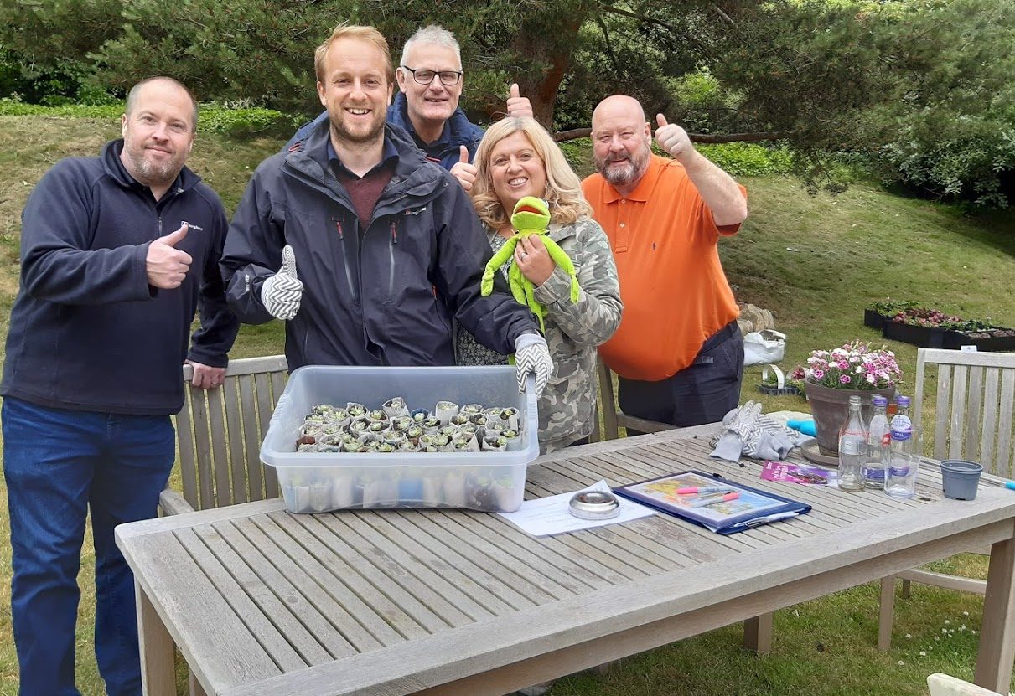
“We really enjoyed all the activities and it provided some simple inspiration for our own gardens along with actions we can take to reduce our CO2 at work and home. It was perfect – fun, adding value, the NHS benefits and we thoroughly enjoyed the event!”

Slide 6
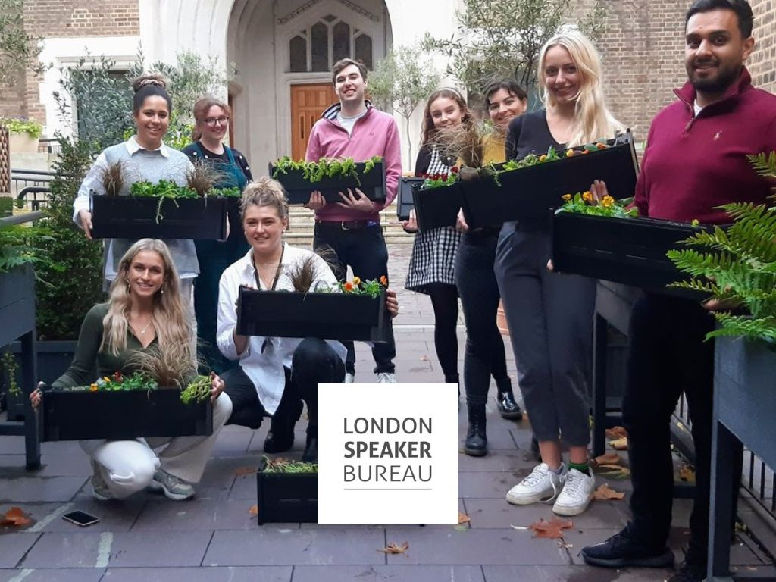

Slide 7
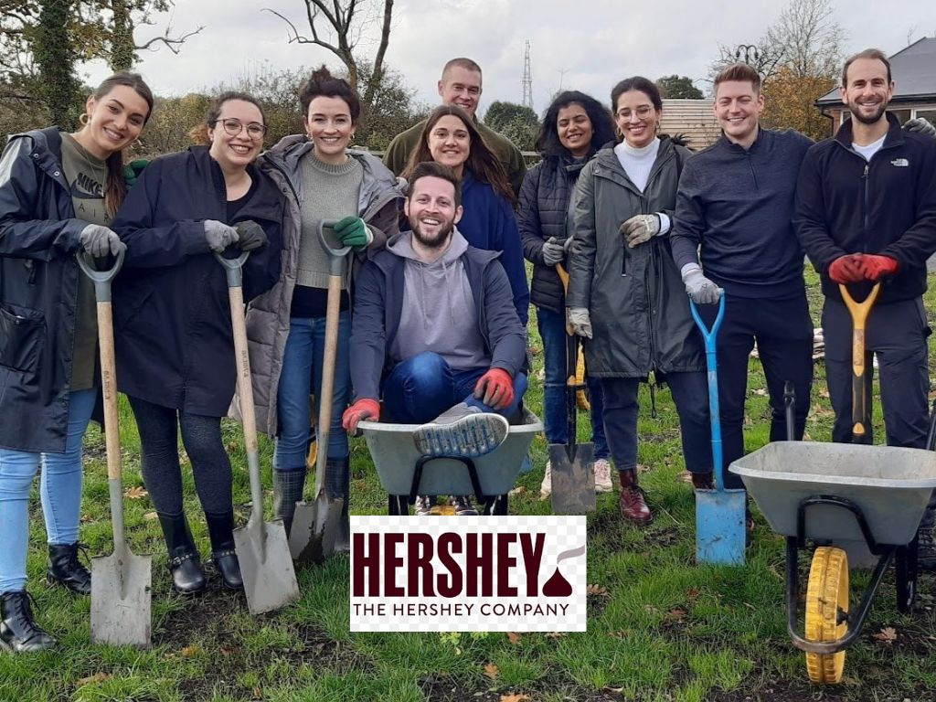

Slide 9
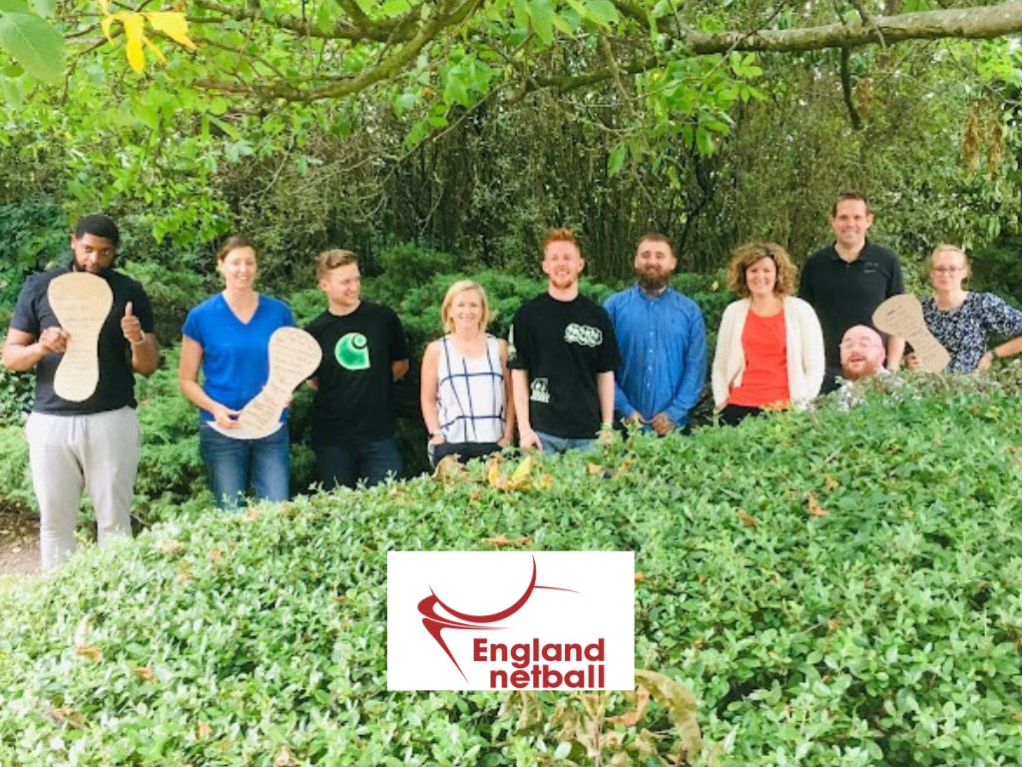

Slide 11
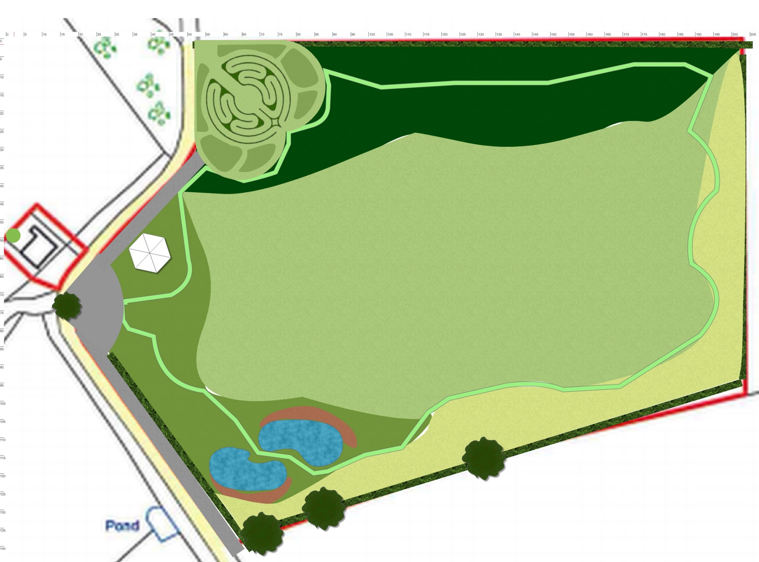
Green Space
Wildflower meadow – Field of Life *
Damselfly Ponds *
Marquee 12m hexagon
Lawn area for fete, archery etc
Parking and turning circle
Willow Hedge and logs
Native hedge
Barn Owl Wood
Forest Garden & labyrinth
Butterfly banks *
Our five acres at CV37 0JA

Slide 12
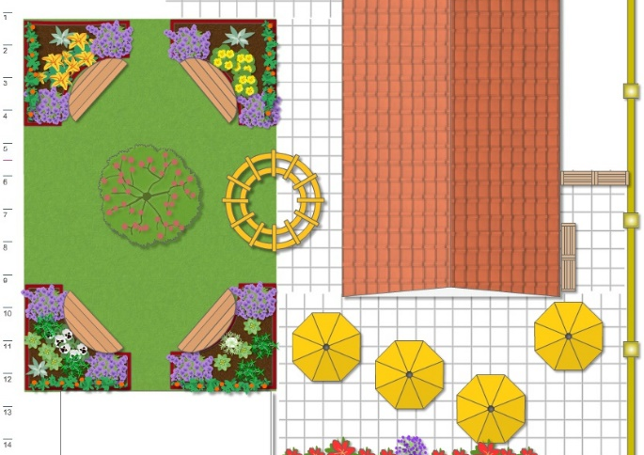
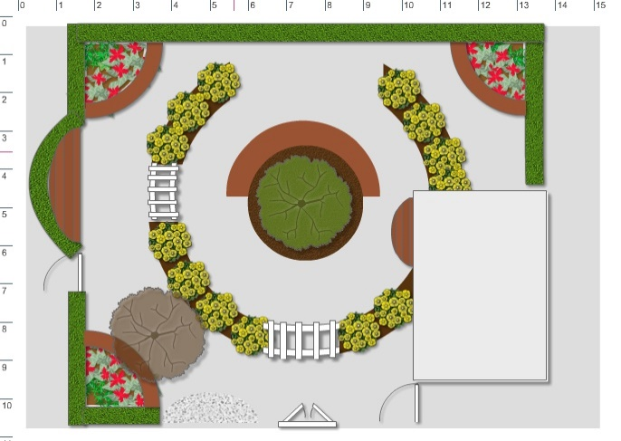
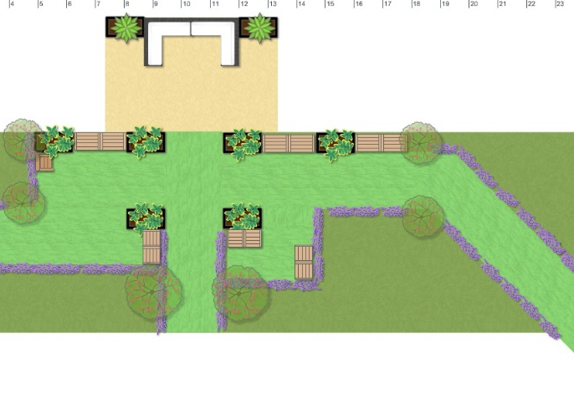
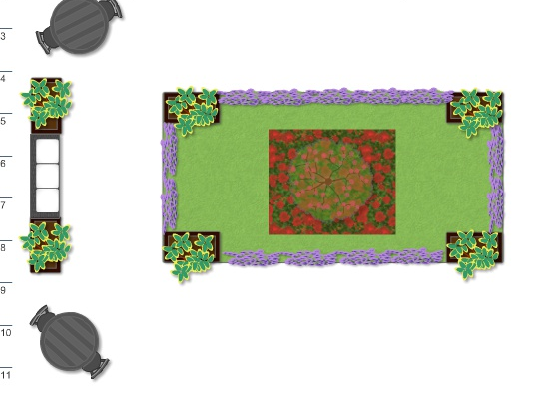
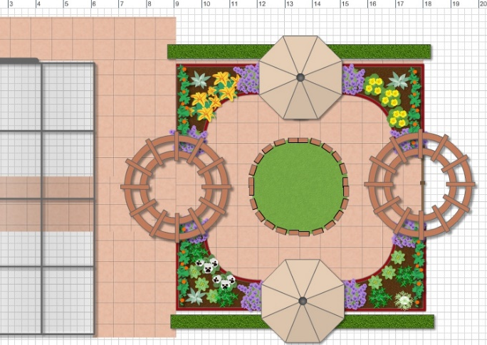
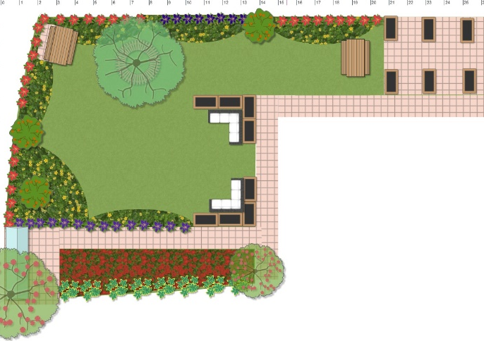
Hospital Gardens of Wellbeing

Slide 13
Learning from the programme
Stop doing and delegate more!
The power of SEO and images
We deliver multiple benefits to companies which like to give back and pay for the events
Nearly half of our income is from services that we don’t even advertise!
Being paid to think was the best gift from the EDP ☺

