Slide 1
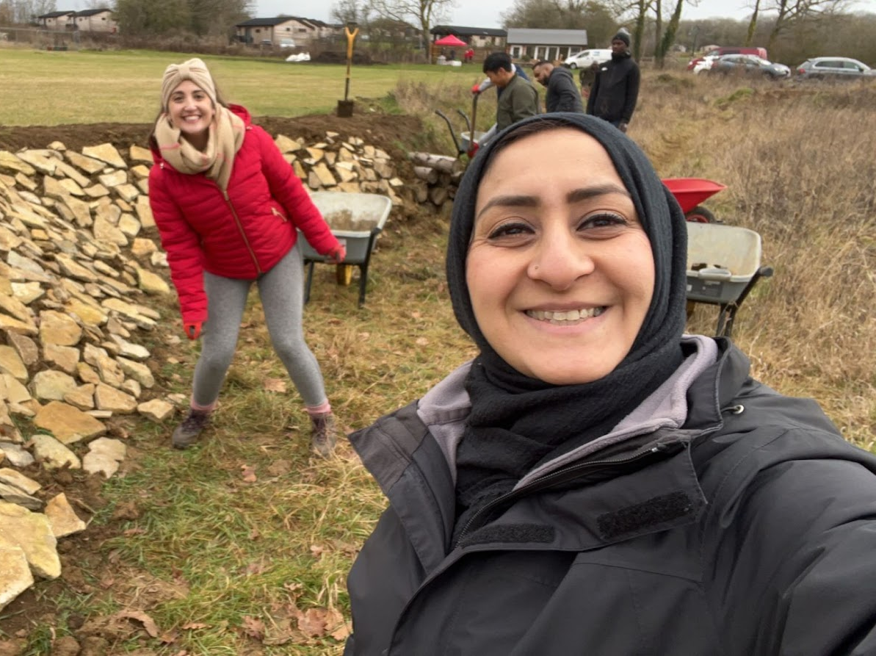
Creating the butterfly bank

Slide 2
Aim
To create and plant a butterfly bank
Introduction
Butterflies indicate a healthy environment and engaging in nature-based activities can have benefits to a person health and wellbeing. A butterfly bank is a simple method to support butterfly populations and serve as a platform for nature-based events.
The principle features of a butterfly bank are that there is lots of bare ground and plenty of plants which serve as caterpillar food and nectar resources for adult butterflies. The ultimate butterfly bank will create a south-facing unshaded slope.
The new butterfly bank should be seeded generously with Kidney Vetch Anthyllis vulneraria, Agrimony Agrimonia eupatoria and Common Bird’s-foot Trefoil Lotus corniculatus so all species become dominant. This is to help the Grizzled and Dingy Skippers colonise and the Small Blue which may require an introduction.

Slide 3
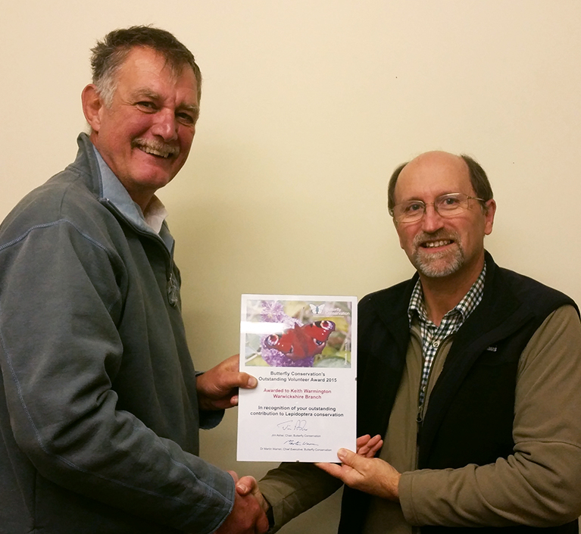
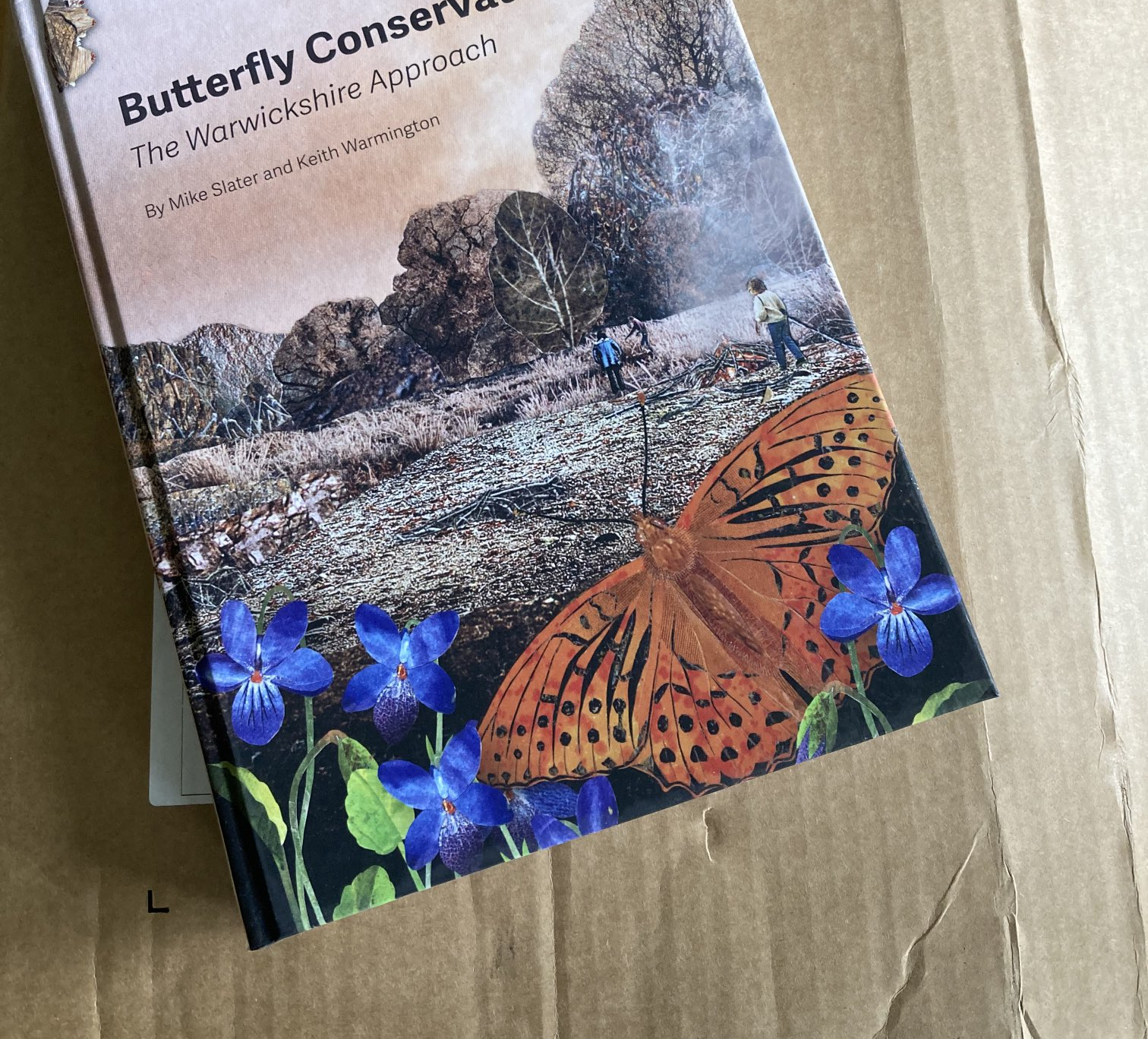
Working with Mike Slater from Warwickshire Butterfly Conservation

Slide 4
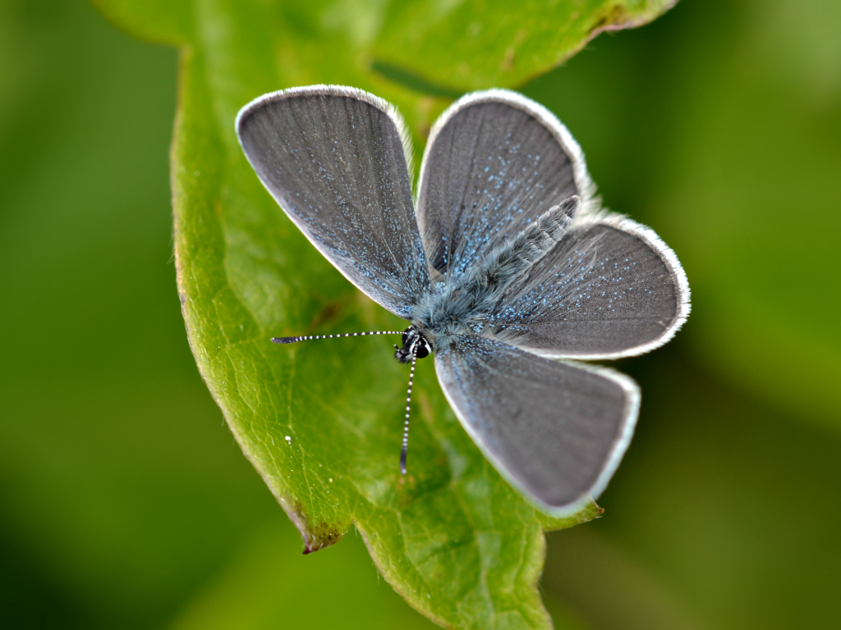
Planting to attract the small blue – needs Kidney Vetch

Slide 5
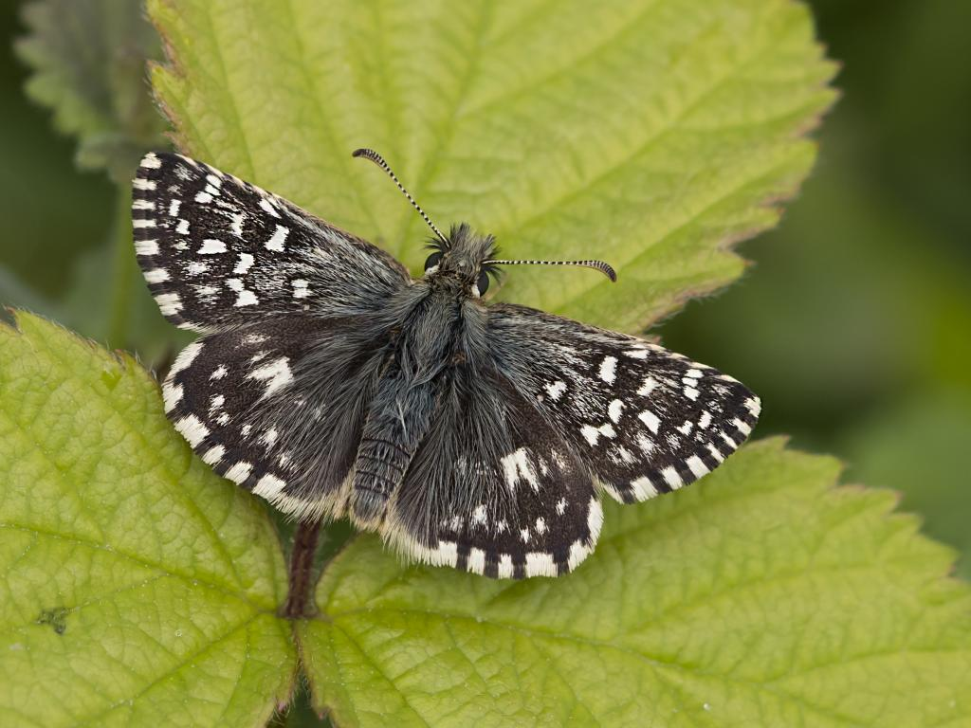
The grizzled skipper – needs agrimony & birdsfoot trefoil

Slide 6
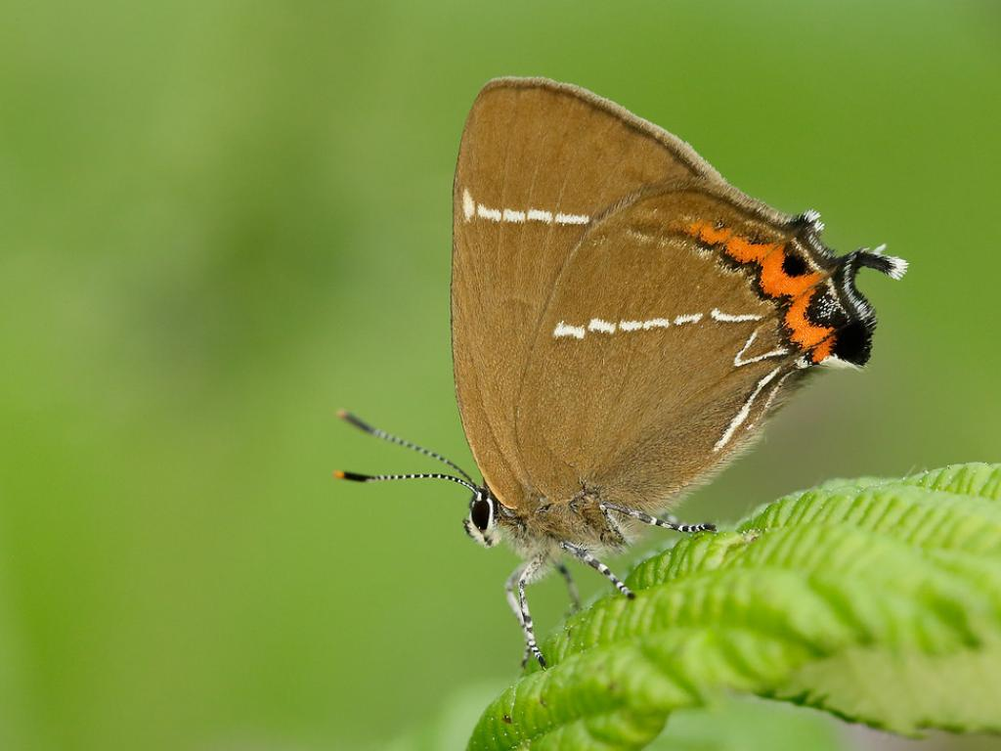
The white letter hairstreak – needs elm trees

Slide 7
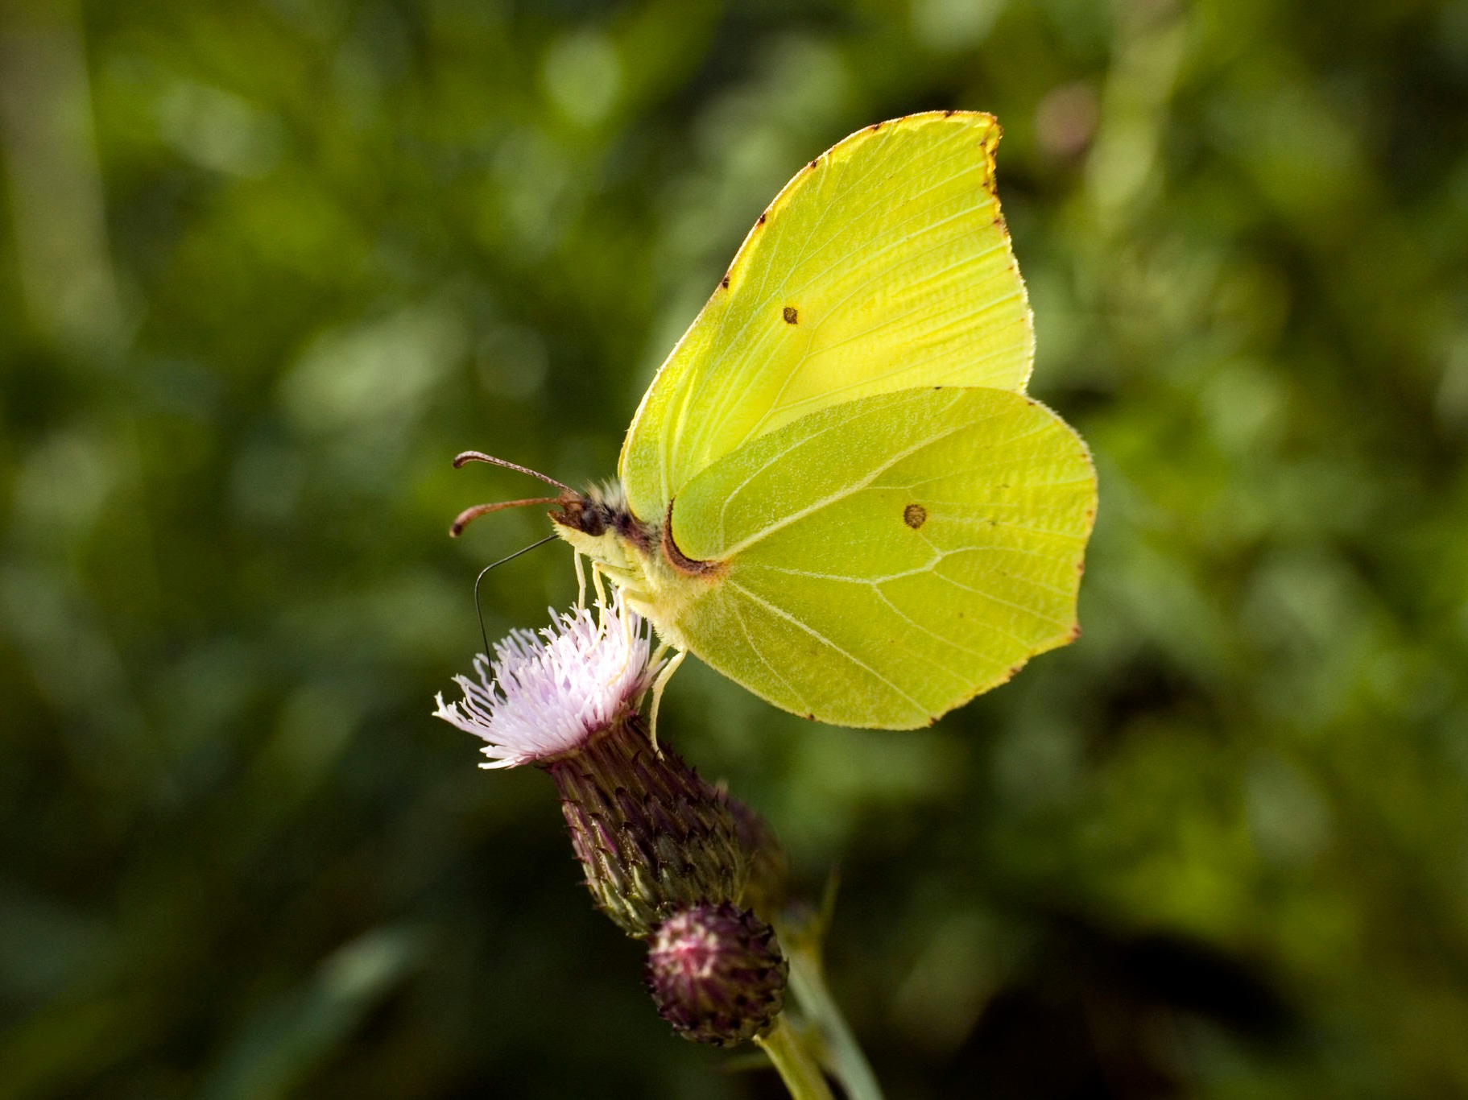
Brimstone – needs Buckthorn

Slide 8
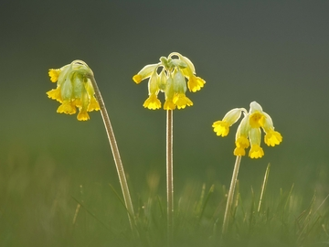
Cowslips are good for bees and butterflies

Slide 9
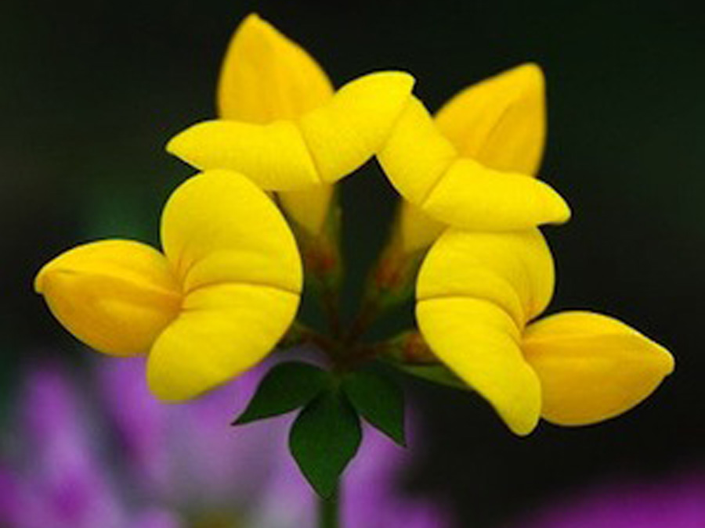
Birdsfoot trefoil

Slide 10
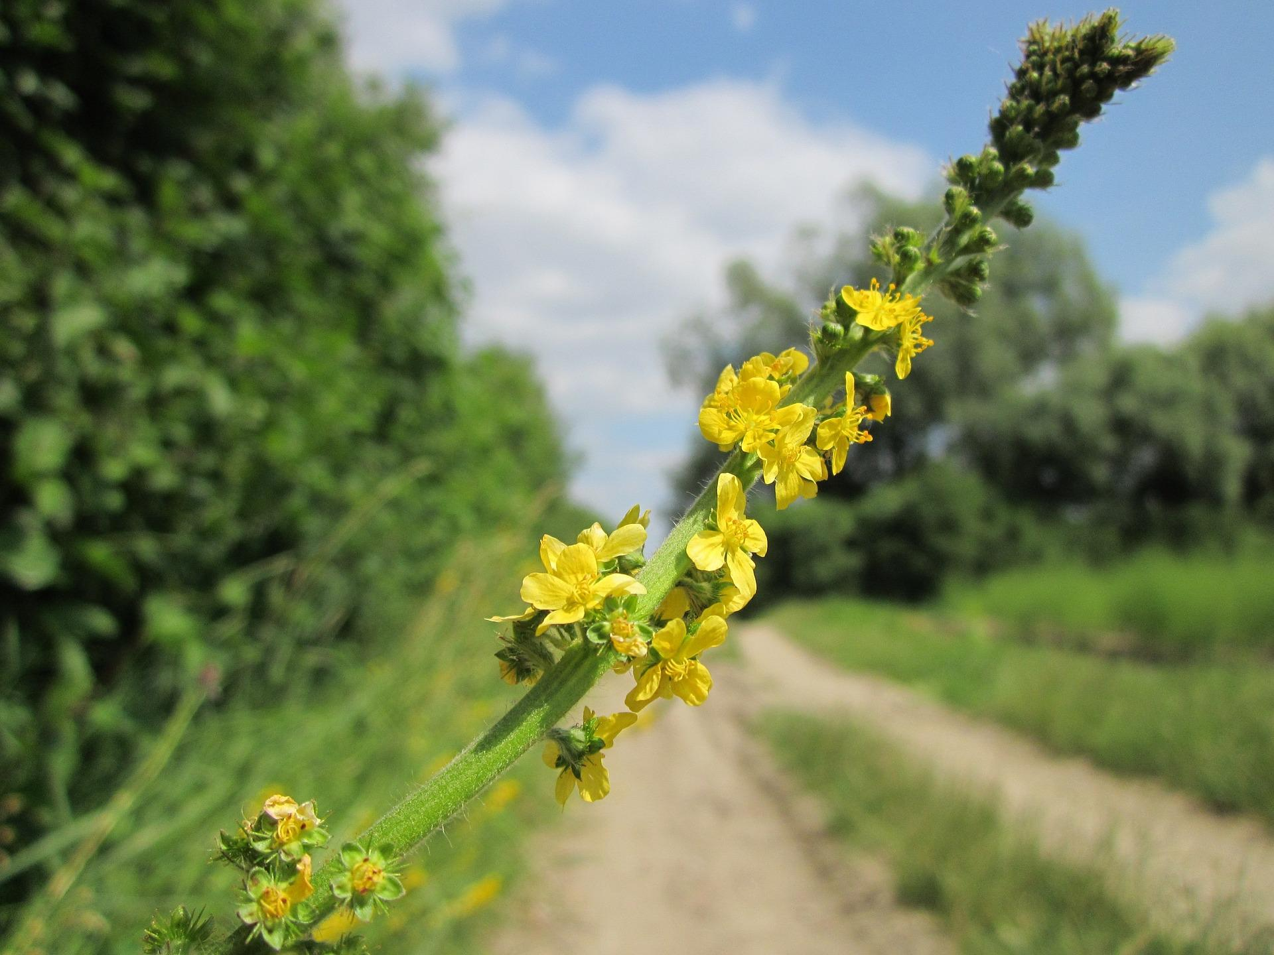
Agrimony

Slide 11
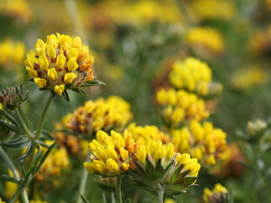
Kidney Vetch

Slide 12
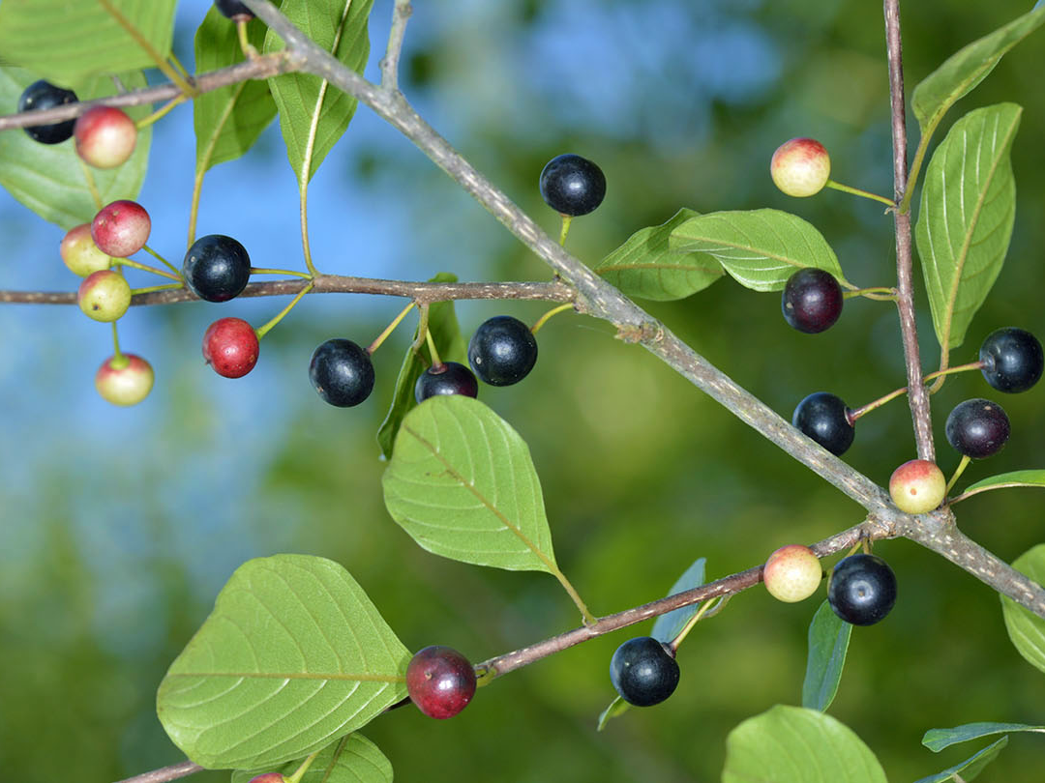
Alder buckthorn for the brimstone

Slide 13
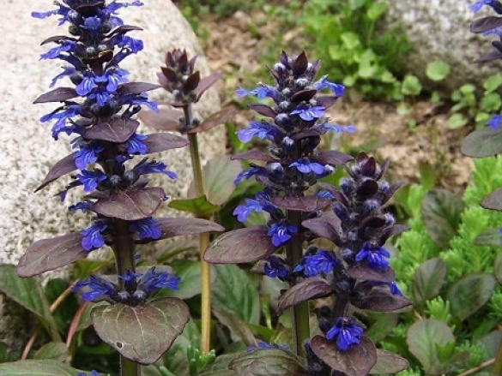
Bugle

Slide 14
Ways to attract butterflies to the site

Slide 15
Recommendations from Mike Slater 23/02/23
•Develop current grasslands into wildflower meadow. Zoe Bell/Sally Eadon should move this forward, if not, there could be alternative funding sources available.
•Review success of meadow creation 12 months later (suggest I carry out a follow up visit to see if additional Wildflowers should be introduced).
•Management of grasslands should be changed to the following regime: -
1.Cut between 15th August and 30th September. Hay/Cuttings should be removed.
2.Leave some areas uncut. Suggest leave a metre uncut for the length of 2 hedges. The following year cut this area and leave a metre uncut on the other 2 hedges. In the following years alternate cutting. The butterfly bank will require cutting annually.
3.It is suggested a circular 1-metre-wide path is cut in the meadow/new woodland area to enable you to walk through it so you can enjoy the wildlife. The path should be cut in approximately mid-June. In proceeding years, the path should be cut to the side of last year’s path in meadow area.
•Plant more Alder Buckthorn Frangula alnus in existing hedgerow and on edge of new woodland for the Brimstone butterfly.

Slide 16
Useful Links
Creating a butterfly bank
Garden butterfly ID sheet
Butterfly Conservation
Big Butterfly Count

Slide 17
Useful Links

